Slide 1


The Essential Guide to the new
Microsoft Certified
Azure Enterprise Data Analyst Associate
DP-500 Exam Guidance
#DataWeekender CU5
Saturday 14th May 2022
Nikola Ilic & Andy Cutler

Slide 2




Your DP-500 van drivers
Nikola Ilic
Andy Cutler
Data Platform Consultant & Trainer
Azure Data Platform Consultant
Datahai.co.uk &
Serverlesssql.com
Data-mozart.com
@DataMozart
@MrAndyCutler
I'm making music from the data!
Power BI and SQL Server addict, MCT, blogger, speaker...
Father of 2, Barca & Leo Messi fan...
Working with Azure Synapse Analytics
Synapse Analytics blogger and speaker
Father of 2, Watford fan...

Slide 3
Microsoft has released a new certification...
Azure Enterprise Data Analyst Associate
One exam: DP-500 Designing and Implementing Enterprise-Scale Analytics Solutions Using Microsoft Azure and Microsoft Power BI
If you work in the space involving Data Analysis and Data Engineering, then this certification is for you.
After this session you'll understand which features and services in Power BI and the Azure Data Platform you need to know when approaching the DP-500 exam with confidence.

Slide 4



Candidate Profile
Expertise in designing, creating, and deploying enterprise-scale data analytics solutions
Responsibilities include
These professionals help
Candidates should have
Cleaning and transforming data
Building enterprise data models
Incorporating advanced analytics
Applying development lifecycles
Collect enterprise-level requirements
Data governance and configurations
Monitor data usage
Optimize performance
Advanced Power BI skills
Power Query and DAX
T-SQL with Synapse Analytics
Visualizing data

Slide 5
Skills Measured Breakdown
Implement and manage a data analytics environment (25–30%)
Query and transform data (20–25%)
Implement and manage data models (25–30%)
Explore and visualize data (20–25%)
49
Total skills measured

Slide 6






Azure Data Platform Services
Purview
Azure DevOps
Synapse Analytics
Power BI
DAX Studio Tabular Editor 2 Vertipaq Analyzer
Data Lake Gen2

Slide 7
Organisational Role Collaboration
Solution Architects
Data Engineers
Power BI Data Analysts
Azure Enterprise Data Analyst
Data Scientists
Database Administrators
AI Engineers

Slide 8

Session Content Breakdown
Microsoft Purview
Power BI
Synapse Analytics
External Tools

Slide 9
Microsoft Purview
Integrating and Scanning Power BI with Microsoft Purview
Using the Data Map and Data Catalog in Microsoft Purview

Slide 10
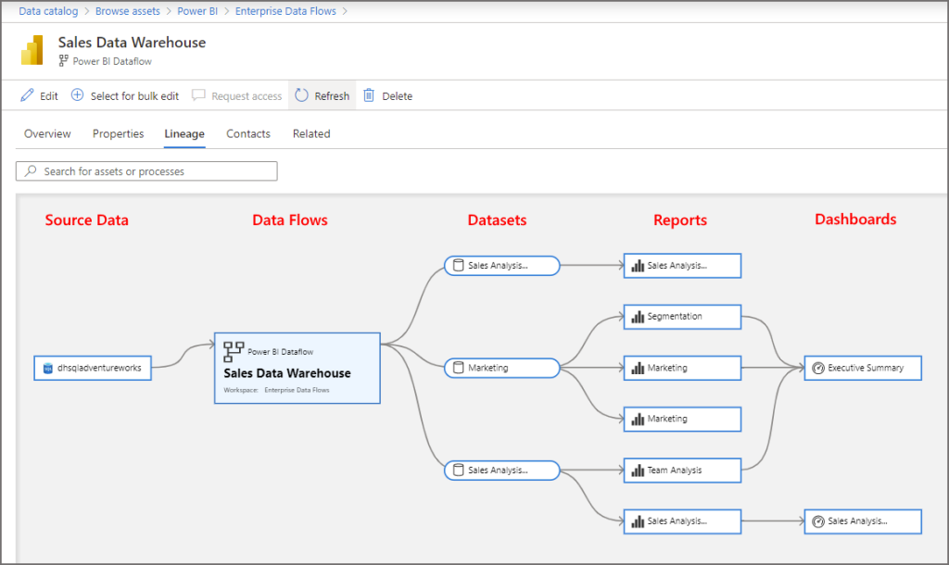
Integrating and Scanning Power BI with Microsoft Purview
Microsoft Purview is a data governance service which catalogues an organisations data estate including Power BI tenants
Purview will scan and register the following assets
Dashboards
Reports
Datasets
Dataflows
Purview will create lineage between Power BI assets and and source data connections

Slide 11
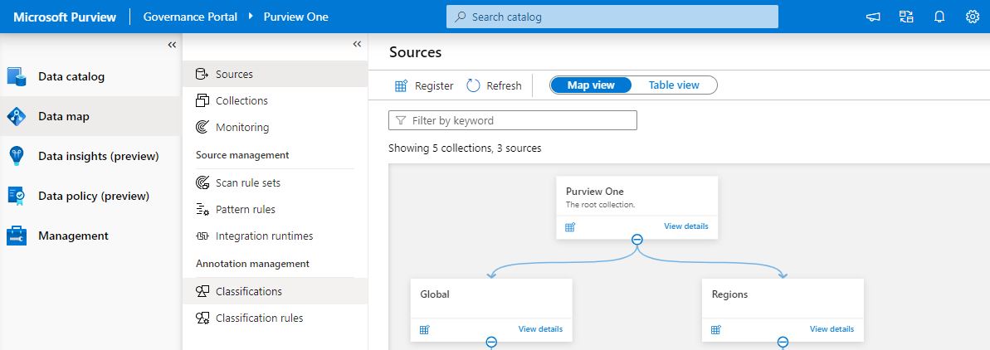
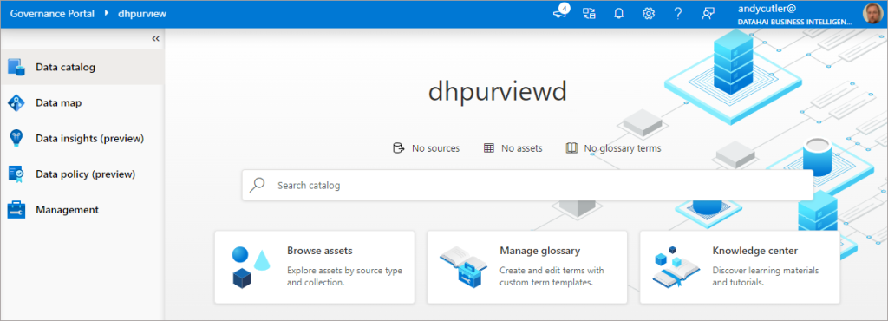
Using the Data Map and Data Catalog in Microsoft Purview
Data Map in Purview allows:
Registering new Data Sources
Viewing data sources in Collections
Initiate Scans on Data Sources
Data Catalog in Purview allows:
Browse assets by either
Collection
Data Source Type
Search for assets
Define and Manage a Business Glossary

Slide 12
Power BI
Data Model Creation & Management
Performance & Optimization
Administration and Governance
Data Visualisation

Slide 13
Composite Models
2 "versions" of Composite models
Combine 1 or more DirectQuery sources
Combine 1 or more DirectQuery sources AND Import mode
Data Model Creation & Management

Slide 14
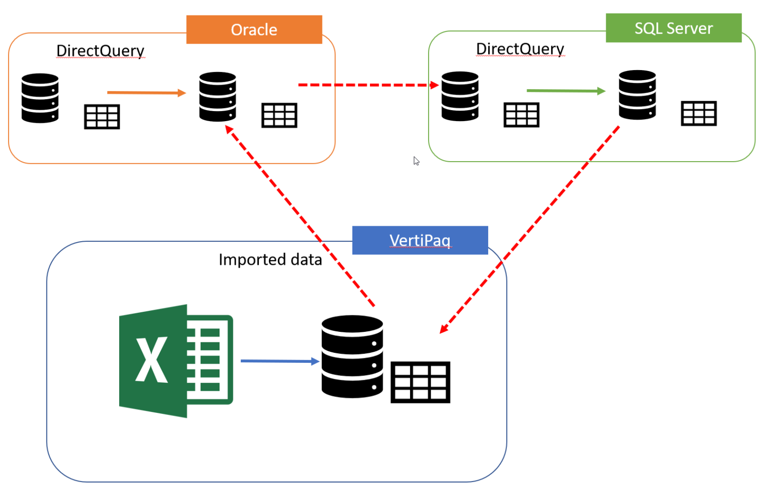
Composite Models
All Imported data = 1 source
Regular vs Limited relationships
Text hinzufügen
Data Model Creation & Management

Slide 15
Aggregations
User-defined vs Automatic
Reducing the amount of data
Make Power BI "aware" of aggregated tables!
Performance & Optimization

Slide 16
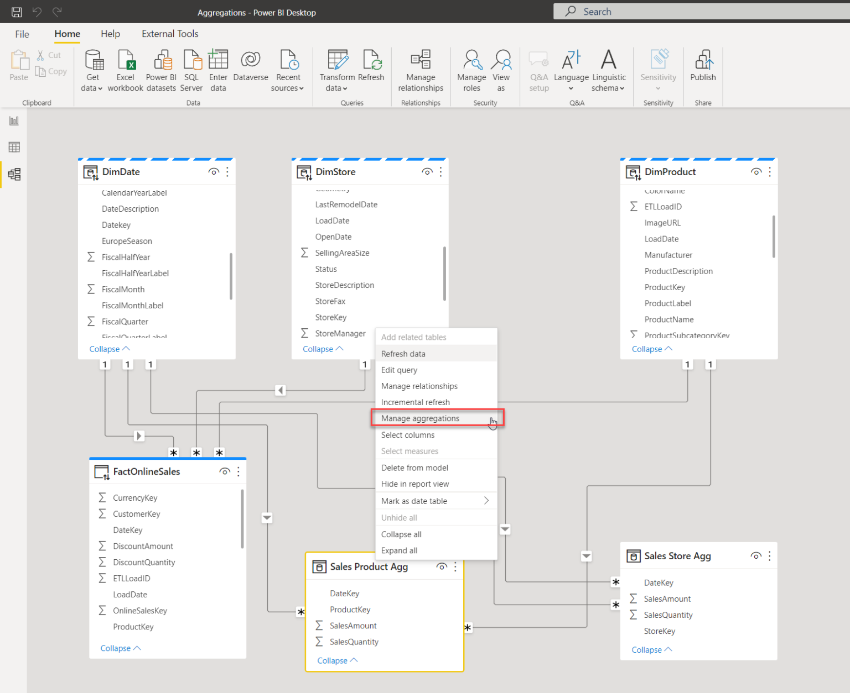
Aggregations
Original table = DirectQuery
Dim tables = Dual
Agg tables = Import
Performance & Optimization

Slide 17
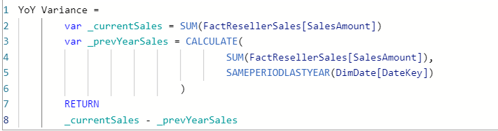

DAX Variables & Handling Blanks
Variables
Blanks
Reusable logic
Code readability
Performance improvement
IF statement
COALESCE()
Be careful!!!
Data Model Creation & Management

Slide 18
Data Refresh Performance
Translate M to a query language
Pushing heavy lifting on the data source
Ability to generate single SQL query that’s going to be executed on the data source side!
Performance & Optimization

Slide 19
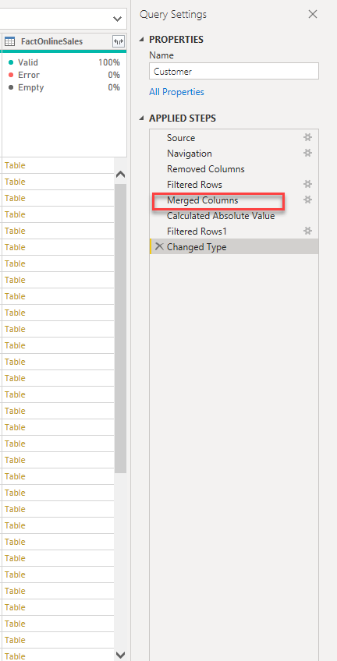
Query Folding – why should I care?
Data refresh more efficient
With DirectQuery/Dual the query must fold!
Incremental refresh
ALL or NOTHING?
Slow report
Slow visuals
Large data model
IT‘S NOT BECAUSE OF QUERY (NON)FOLDING!!!
Performance & Optimization

Slide 20

Direct Query Scenarios
Data is too large for Import mode
Real-time reporting requirements
Is it really necessary?
Security policies on the data source side
Performance & Optimization

Slide 21
Licensing Options
User
Capacity
Pay-per-user
10 $/month PRO
20$/month Premium
Pay-per-capacity
Price depends on the capacity features
Assigning CONTENT to capacity
Administration and Governance

Slide 22
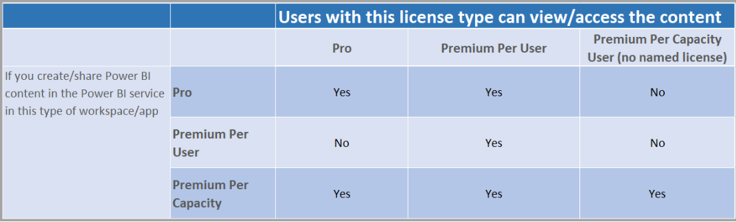
Sharing Options
Premium capacity makes sense for large number of consumers: 250-500+
Premium capacity makes sense for very large data models
Premium-per-user makes sense for small number of users that need premium features
Administration and Governance

Slide 23
Creating Reusable Assets
PBIX
Contains connections, datasets, transformations, visualizations...including data!
PBIT
No data! Only metadata (data model, pages...)
PBIDS
Saves only the link to the data source
Administration and Governance

Slide 24
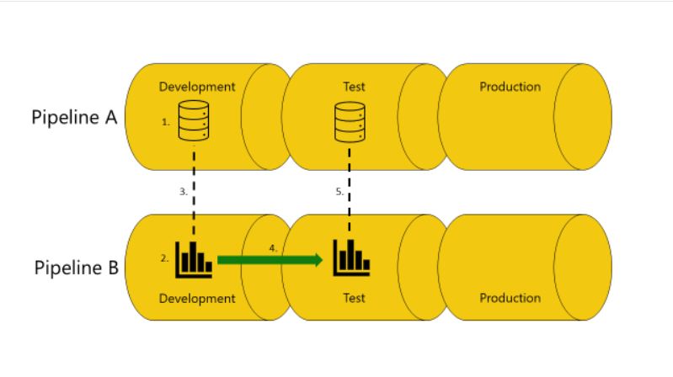
Deployment Pipelines
Permissions managed separately from workspace permissions
Configure parameter rules
Automation with Azure DevOps and APIs
PREMIUM ONLY!
Administration and Governance

Slide 25


Designing for Accessibility
Normal
Green-Blind (Deuteranopia)
Data Visualisation

Slide 26
Accessibility Features
Built-in
Configurable
Keyboard navigation
Screen reader
High contrast color
Focus mode
Show data table
Alt text
Tab order
Labels & Titles
Markers
Themes, contrast, colors
Data Visualisation

Slide 27
Azure Synapse Analytics
Integrate Power BI Workspace with Synapse Analytics Studio
Dedicated and Serverless SQL Pools
Querying Data Lake using Serverless SQL Pools
Querying Complex Data using Serverless
Creating Spark notebook visuals
Creating Synapse Studio visuals
Using PREDICT function

Slide 28
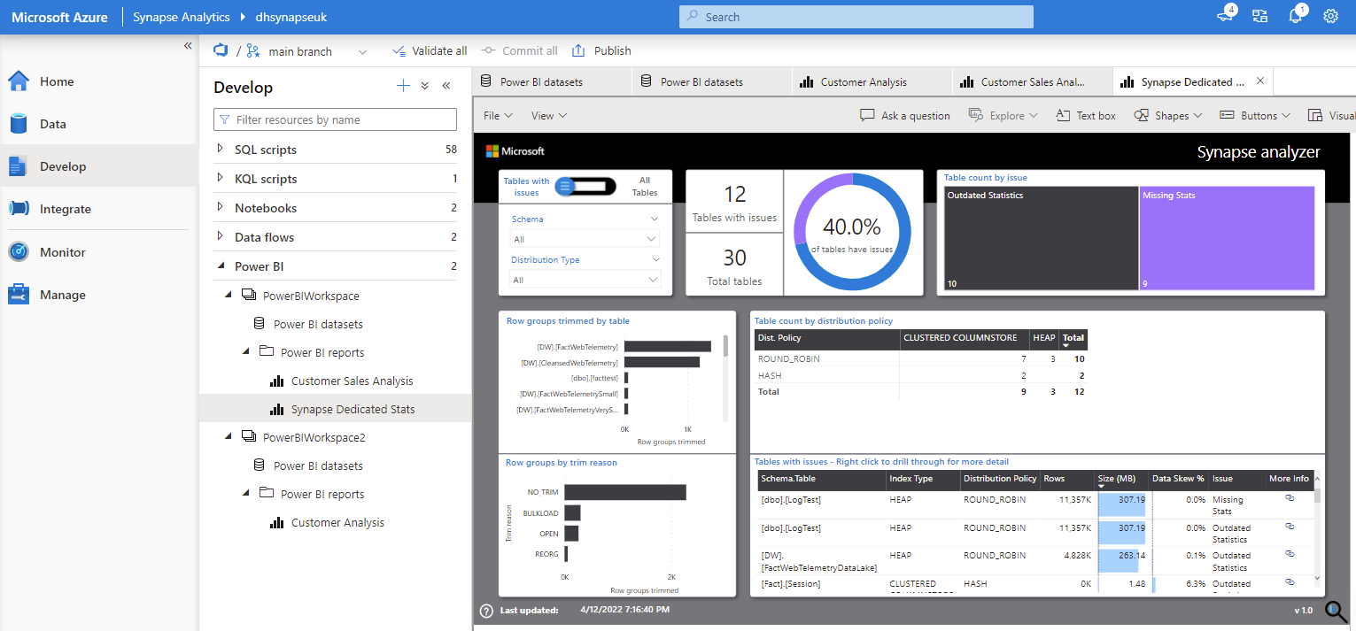
Integrate Power BI Workspace with Synapse Analytics Studio
Power BI can be integrated into an Azure Synapse Analytics workspace
Multiple workspaces supported by creating multiple Linked Services
Create Datasets from either Dedicated or Serverless SQL Pools
Power BI Desktop is required to open the .pbids file (Data Connection)
Create & edit Reports from Datasets
Report authoring is available
From within Synapse Studio
Datasets cannot be created or edited in Synapse Studio, this must be done by Power BI Desktop

Slide 29
Dedicated and Serverless SQL Pools
Dedicated SQL Pools
Serverless SQL Pools
Data exists within internal distributed tables
Supports large amounts of data (measured in Terabytes)
Query Concurrency scales with the service tier, measured in DWUs
Supports Data Masking and Column-Level Encryption
Data exists external to Synapse Analytics, no data is imported
Supports Azure Storage, Data Lake Gen1 and Data Lake Gen2
Can create External Tables and Views
Supports Managed Identity, Service Principal and User Identity

Slide 30


Querying Data Lake using Serverless SQL Pools
Service which is used to query data
external to Synapse Analytics
Azure Storage
Azure Data Lake Gen1 & Gen2
Write using
CREATE EXTERNAL TABLE AS SELECT
Read and Write (to Azure Storage)
Uses the OPENROWSET command
filepath(*) is used to select partitions
filename() is used to return the file name
External Tables and Views are supported
Cost is based on amount of Data Processed
No configuration of Serverless required
Read
SQL Clients
Cosmos DB
Serverless SQL Pools
Dataverse

Slide 31
Querying Complex Data using Serverless SQL Pools
Serverless SQL Pools supports querying complex data in JSON and Parquet format
JSON
Parquet
Format needs to be set to CSV in OPENROWSET
Set 0x0b as the value for
fieldterminator
fieldquote
Rowterminator (classic JSON)
Supports
JSON_VALUE (extracts scalar value)
JSON_QUERY (non-scalar e.g. an array)
OPENJSON (explode & join to Parent row)
Format needs to be set to PARQUET in OPENROWSET
Supports
JSON_VALUE (extracts scalar value)
JSON_QUERY (non-scalar e.g. an array)
OPENJSON (explode & join to Parent row)

Slide 32
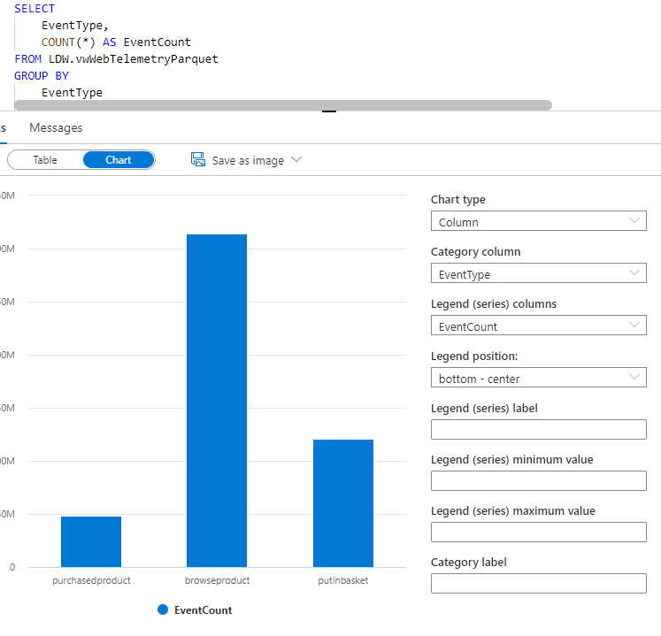
Creating Synapse Studio visuals
Within Synapse Studio, we are able to create data visualisations
Querying data within a Synapse SQL Pool database results in either a Table or Chart visual.
By clicking the Chart option, the following cxhart types are visible:
Area
Bar
Column
Line
Pie
Scatter
Charting options are limited

Slide 33

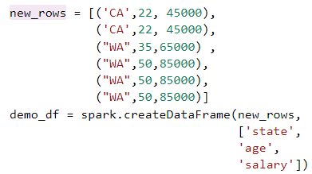
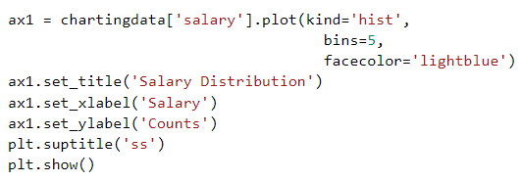

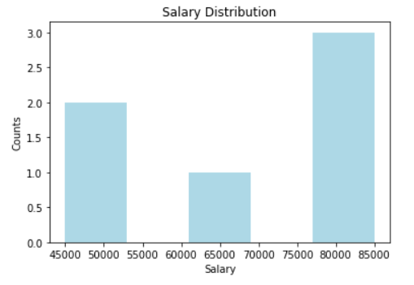
Creating Spark Notebook Visuals
Within Spark notebooks, libraries can be added to enable data visualisations
Import Matplotlib libraries
Create Dataframe with data
Use Pandas with Dataframe
Create chart from Pandas
In this scenario we import the libraries, load a pandas dataframe, then visualise

Slide 34
Using PREDICT function
PREDICT is a T-SQL function supported within Dedicated SQL Pools and is used to score data for predictive analysis
Only supports ONNX runtime
Need to DECLARE the model and load into a variable
Use VARBINARY(MAX) when storing the model
Assign DATA from CTE, Table, View, or Table Valued Function
DECLARE @model VARBINARY(max) = (
SELECT DATA
FROM dbo.models
WHERE id = 1
);
WITH predict_input
AS (
SELECT CustomerID, Age, DIS, RAD, TAX, PTRATIO
FROM dbo.Customers
)
SELECT predict_input.id, p.variable1 AS MEDV
FROM PREDICT
(MODEL = @model
DATA = predict_input,
RUNTIME=ONNX)
WITH (variable1 FLOAT) AS p;

Slide 35
External Tools
DAX Studio
Tabular Editor
Vertipaq Analyzer

Slide 36

DAX Studio
Write DAX
Performance tuning
Understand query plans
Server timings – FE vs SE

Slide 37

Tabular Editor
Manipulate TOM
Calculation groups
Object-level security
Custom KPIs

Slide 38

VertiPaq Analyzer
Collect data from DMVs
VertiPaq storage structures
Data model size

Slide 39


Learning Resources
Serverlesssql.com
Data-Mozart.com

Slide 40
Thank you!

Slide 41
Nikola Ilic
Andy Cutler
Data Platform Consultant & Trainer
Azure Data Platform Consultant
Data-mozart.com
Datahai.co.uk & Serverlesssql.com
@DataMozart
@MrAndyCutler

